Slide 1
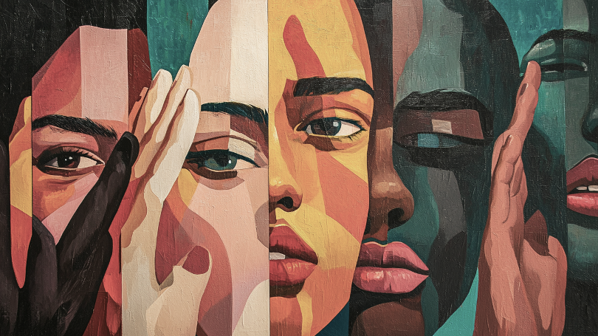
Lord of the years, You have been our witness,
through the Baptist generations:
You have seen all - of what only some of us could see, You have heard all - of what only some of us would hear, You have known all - of what we only knew or admitted in part, about the women in our midst.

Slide 2
God of our years,
You have been our witness
weeping when only a few of us shed tears: and cried ‘how long, O God, how long?’
And then, when still only some of us sought justice. You said, ‘this is enough!’

Slide 3
So come, God now, to your people in this year: as we seek once again to live in your light, and embrace your truth,
to change our hearts, our minds, our lives.

Slide 4
For we have claimed to walk with one another, but have denied women the path: added burdens to their journey,
left obstacles in their way:
As individuals we have done this,
but Churches, Associations and Colleges are complicit too.

Slide 5
As a movement of Baptists,
we have failed to be allies,
of those you have chosen,
we have broken the body of Christ,
we have quenched your Holy Spirit. and wounded any witness to the world.

Slide 6
We have claimed to watch over one another, but have left women to struggle alone, we have wearied their passion, excluded their bodies,
silenced their voices, doubted their vocation,
to be present,
to be speak,
to celebrate and be celebrated.

Slide 7
As individuals we have done this,
but Churches, Associations and Colleges are complicit too.
As a movement of Baptists
we have failed to be allies,
we have broken the body of Christ,
we have quenched your Holy Spirit, and wounded any witness to the world.

Slide 8
But now you have come, God of our years,
Moving among us with new light and truth, Through diligent research,
and determined women.
Their story is Your story Your witness is ours.
Your story is their story Their witness is ours.

Slide 9
Your Spirit, through them, is upon us:
In response we repent:
and turn from our old ways;
old ways whose day is no more,
old ways whose time has gone,
old ways that are welcome among us no more.

Slide 10
We can no longer say:
‘God, we didn’t know!’
‘It was normal for then!’
Or ‘I don’t know what I can do!’
No!
Now we can affirm:
in the Power of the Spirit:

Slide 11
We will not drink from stagnant wells of cheapened grace,
that privilege men.
We will not plumb the broken cisterns of convenient theological alibis,
that silence sisters.

Slide 12
But we will seek out the fresh streams of justice the rolling rivers of resistance and joy,
as women and men,
together in Christ
alive in the Spirit, we will do this.

Slide 13
As Churches, Associations and Colleges, we will walk again with one another,
and watch over one another,
allies in the light and truth
that has found its home among us.

Slide 14
God of our years,
You are witness to our generation.
Confirm on earth,
these words of our mouth, O God,
Confirm on earth,
this work of our hands, O God,
Confirm on earth
the prayer of our hearts, O God,

Slide 15
O God, confirm all this upon the earth, bear witness to our lives,
turn our lamentation into praise, until all heaven rejoices,
with justice and joy,
Let all heaven and earth rejoice.

